Slide 1
(K&M)² Inc.
Ping Pong Ball and Golf Ball Moving System
Musse Abdullahi,
Kyle Derby MacInnis,
Maria Shmerko,
Kurt Stuart

Slide 2
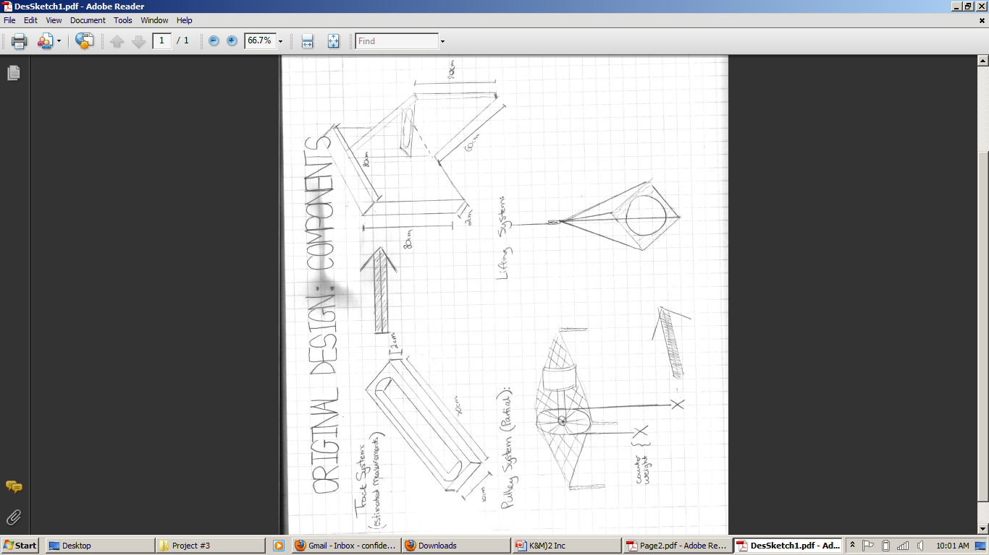
Original Design

Slide 3
Estimated Cost
Based on our original design our estimated cost was around:
$5.00 - $10.00
This mainly was due to the fact that we had most of the materials already accessible.

Slide 4
Risks
Risks
Solutions
Material Failure
Structure Failure
Too Much momentum
Ball might bounce
Golf Ball falls through
Damage caused by transportation
Stress Testing
Stress Testing
Practise run-throughs
Gel-Pack in Cup
Practise Run-throughs
Fine tuning

Slide 5
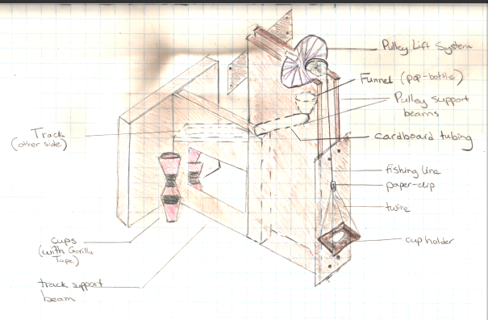
Final Design

Slide 6
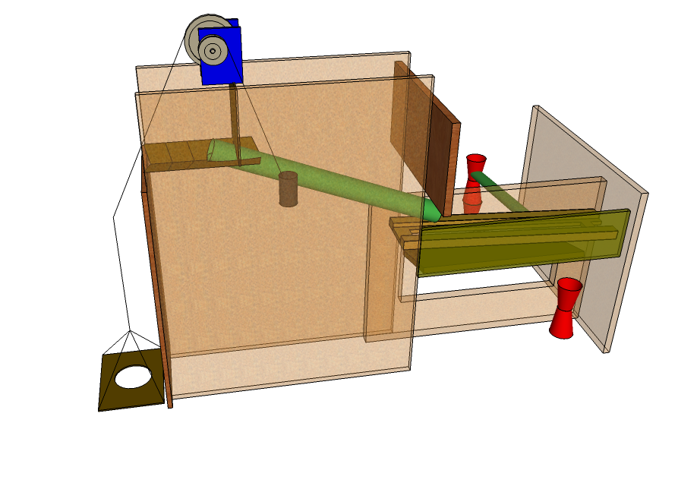
Final Design

Slide 7
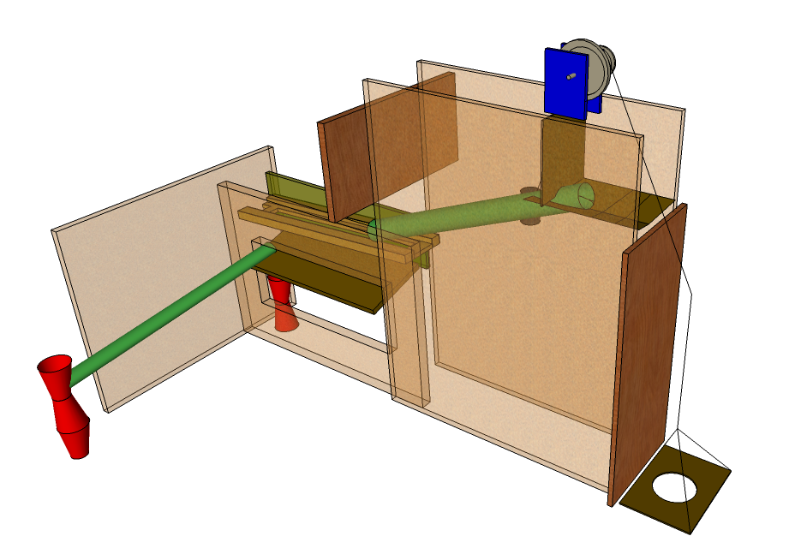
Final Design

Slide 8
Notable Changes
Lift Support System
We chose to use a cardboard base in order to better carry the cup
Pulley Device
We chose to use two wheels in order to maximize efficiency
Separating Ramp
Used a wooden ramp with a hole cut through it.
Tracking
Used cardboard tubes

Slide 9
Actual Cost
Our actual cost after all the materials and requirements had been purchase was:
$15.00-$20.00
This was due to having to purchase some additional tools, and materials which weren’t accessible to us.
Drill bits / Tape / New tubes / Fishing Line

Slide 10
Problems Faced
Custom Materials
We had to abstractly think about how to use the materials we already had when we were designing it.
Structural Integrity
We had to make sure that our design could handle the stresses and the size.
Cost
We tried to make sure we used materials we had access to in order to maintain low costs.

Slide 11
Risk Mitigation
Weekly meetings
This allowed us to keep track of our progress
Stress Testing
We made sure to test for any problems during runtime
Strong materials
Made sure that our design and materials were well built
Log Keeping
Allowed us to keep a record of our meetings and individual work
Budget Management
Made sure we did not go over budget.

Slide 12
Post-Completion Reflection
After completion of the project we feel that we would like to change certain things:
Finding more recyclable materials
Have more weekly meetings
Find better ways to set schedules/Meetings
Start construction sooner
We felt that our design phase went very well and our idea to keep a ledger was a smart decision. These helped make the project run much more smoothly.

Slide 13
Group Structure
Kyle – Presentation Manager/ 3D Modeller / Material Gathering/ Construction Aid/ Design Consultant
Kurt – Team Coordinator/ Material Gathering/ Construction Leader / Design Consultant
Maria – Technical Sketch Artist/ Material Gathering/ Team Scribe/ Design Consultant
Musse – Conflict Evaluator / Design Consultant

Slide 14
Team Effectiveness
For the most part our team was very effective. We worked well together and each had ideas to pool.
We did have some scheduling conflicts but were able to work around it, and the members who were able to make it collaborated in order to complete the necessary tasks.
We completed our project on time due to our cooperation.

Slide 15
Estimated Timeline
Originally our time line was set out to be very general.
We did not wish to impose micromanagement on the group in order to foster a calm environment.
All of our deadlines were set for the weekend of October 22, 23, and 24.
This gave us time in order to work around each of our schedules.

Slide 16
Timeline Adherence
For the most part we kept to our time line. There were only a few things we weren’t on time with:
3D Model
Technical Sketches
Presentation
We were on time for:
Material Gathering
Design discussions
Machine Construction
Stress Testing

Slide 17
Group Challenges
Communication Loss between members
Schedules were sometimes forgotten
Finding times within our schedules that worked for each member.
Certain meetings didn’t have all the members
Discovering and using each member’s strengths.
Distributing tasks based on strengths of the members

Slide 18
Conclusion
In our project we were able to complete our purpose. We designed and built a machine which was able to lift up a cup, and separate a golf ball from a ping pong ball and place them in their respective cups.
We did not deviate from the required cost.
We were successful because we implemented good design practises and followed through with our deadlines.

